Slide 1
Hack the Future:
A Gen AI Sprint Powered by Data

Slide 2
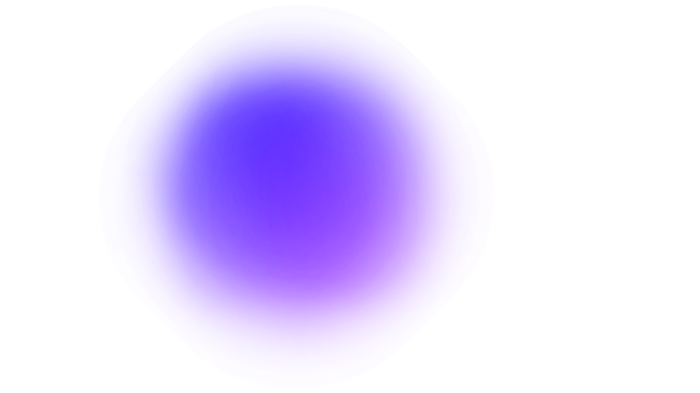
Guidelines
The template should consist of the following and it is mandated to be used by your team for submitting your innovative ideas/solutions. Follow file naming format: Team name_Idea Name.pptx

Slide 3




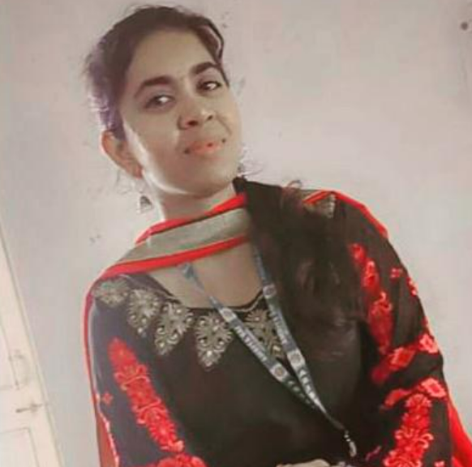
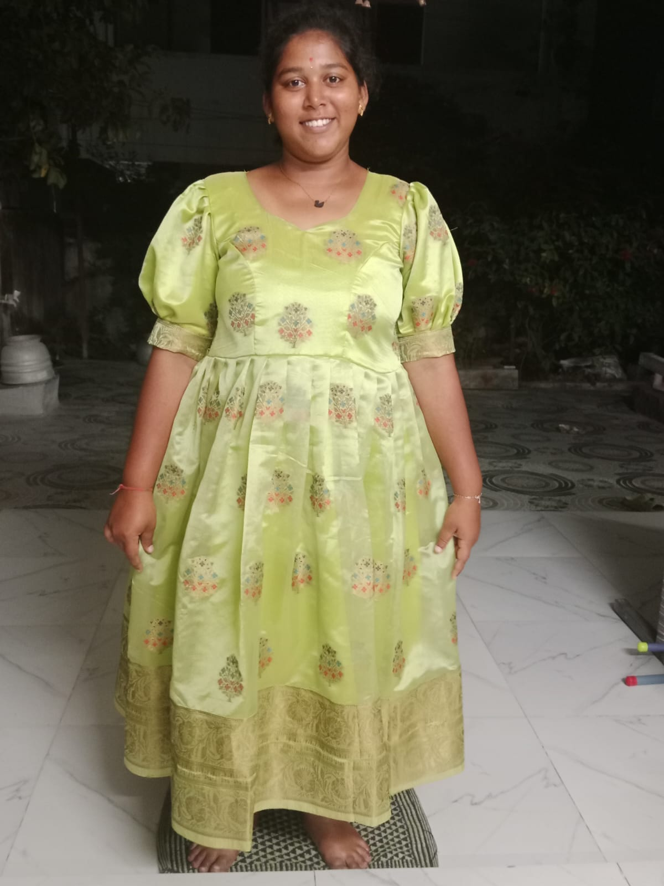
Hack the Future: A Gen AI Sprint Powered by Data
Data and AI Week
Team details
TEAM NAME: poojitha_dirisala
Sai Poojitha (Team Leader)
Sumana Sri
Photo

Slide 4
Entry Submission Summary
Idea Title (Provide a concise and impactful title for your idea.) | Title: AI-Powered Early Disease Diagnosis Assistant Domain: AI in Health care Brief: We’re building a smart tool that helps doctors identify diseases early by analyzing patient’s symptoms and past health records
Team Name | Poojitha_dirisala
Problem Statement | In many hospitals, doctor’s rely on what patients say during visits and manual review of reports. This leads to delayed or missed diagnosis, especially in rural areas where access specialists is limited. There’s a strong need for a support system that can go through records quickly and suggest possible health issues in time.
Proposed Solution | We’re building a web-based assistant that reads symptoms(ty[ed or spoken), checks them against medical data, and suggest possible conditions. It’ll also recommend what tests can be done next. This can help doctors make faster and more accurate decisions, especially in crowded or overloaded hospitals.

Slide 5
Problem statement you are trying to address
In the current healthcare system, timely and accurate diagnosis plays a crucial role in determining the effectiveness of treatment. However, due to time constraints, human error, or lack of access to complete patient records, doctors may sometimes miss early signs of diseases. This becomes especially problematic in rural or overloaded urban hospitals, where physicians have to manage large patient volumes with limited resources. Many patients present vague or overlapping symptoms, making it hard to identify the exact cause without additional support.
There is a growing need for a supportive system that can analyze patient symptoms and medical history holistically. An AI-based assistant can help bridge this gap by processing patient inputs using natural language processing and predicting potential diagnoses based on patterns learned from medical data. Such a solution not only assists doctors in making faster decisions but also ensures that critical health conditions are not overlooked at the early stages.

Slide 6
Proposed Solution Overview
Brief approach description or methodology used to tackle the problem
Our solution is an AI-powered web-based assistant designed to support doctors during the diagnosis process. The system allows doctors or healthcare staff to enter patient symptoms and upload past medical records or history. Using Natural Language Processing (NLP), the tool extracts relevant information from the input text, such as recurring symptoms, medical terms, and historical conditions.
Once the data is processed, a trained Machine Learning model compares the input with a medical dataset to identify patterns and predict the most likely diagnoses. It also suggests the most appropriate next steps, such as diagnostic tests or specialist referrals. The tool is designed to learn over time and improve its predictions based on real feedback. By combining NLP and predictive modeling, the system ensures quick and informed decision-making, especially in high-pressure or resource-limited settings.

Slide 7
Technologies Used
List the key technologies, frameworks, and tools you utilized in your solution
Frontend: HTML/CSS/JS or Streamlit
Backend: Python (Flask/Django)
ML/NLP: scikit-learn, spaCy, BERT
Database: MongoDB / PostgreSQL
Hosting: Heroku, AWS, or Render
I can change or add any other frame works needed in the project in the coming days , to ensure project reliability and accessibility

Slide 8
Agents' interaction design
User Interface: Doctor enters symptoms and uploads patient records.
NLP Module: Processes text using trained models to extract keywords (symptoms, conditions).
Prediction Engine: ML model compares data with medical dataset to suggest probable diagnoses.
Recommendation Module: Suggests relevant tests or referrals.
Output: Doctor receives a list of possible conditions, risk levels, and suggested action

Slide 9
Code structure
We are developing a working prototype using Streamlit to demonstrate the functionality. The user inputs symptoms and history, and the system returns possible diagnoses with recommended tests. We aim to integrate a sample medical dataset for realistic testing.
Innovation & Uniqueness
Combines NLP + ML for practical use in real-time diagnosis.
Focuses on helping doctors, not replacing them — a true assistant.
Can be customized for rural clinics or even integrated with telemedicine.
Multilingual support possible for Indian regional languages.

Slide 10
Conclusion
Summarize the impact and effectiveness of your solution. Reiterate how it solves the problem statement.
The AI-based Healthcare Assistant addresses the pressing need for accessible, real-time, and intelligent medical support, especially in underserved or remote regions. By analyzing patient symptoms using natural language processing and machine learning algorithms, it offers preliminary diagnoses and health recommendations with high accuracy.
This solution reduces dependency on immediate physical consultations, eases the burden on healthcare systems, and empowers individuals to take early action regarding their health. With its ability to scale, learn, and adapt, the system ensures fast, affordable, and reliable healthcare support—solving the original problem of delayed or inaccessible medical attention effectively.

Slide 11
References/Other details
World Health Organization – www.who.int
IBM Watson Health – www.ibm.com/watson-health
scikit-learn Machine Learning Library – https://scikit-learn.org
Natural Language Toolkit (NLTK) – https://www.nltk.org
[IEEE Xplore] AI-Powered Diagnosis Systems – https://ieeexplore.ieee.org

Slide 12
Thank You

